Slide 1
INTELLIGENT ROAD TRAFFIC
CONTROL SYSTEM

Slide 2
- One study done in Boston has proved -
Reconfiguring the timings of
60 intersections
in one district in the city
could save $1.2 million / year

Slide 3
Time based Implementation

Slide 4

4x30s
2 mins
Traditional
2x30s
1 min
Our

Slide 5
Our Implementation

Slide 6
Take a region
on each lane
1
Fix counters at two ends
2
Count incoming, outgoing number of vehicles
3
Take the
difference
4

Slide 7
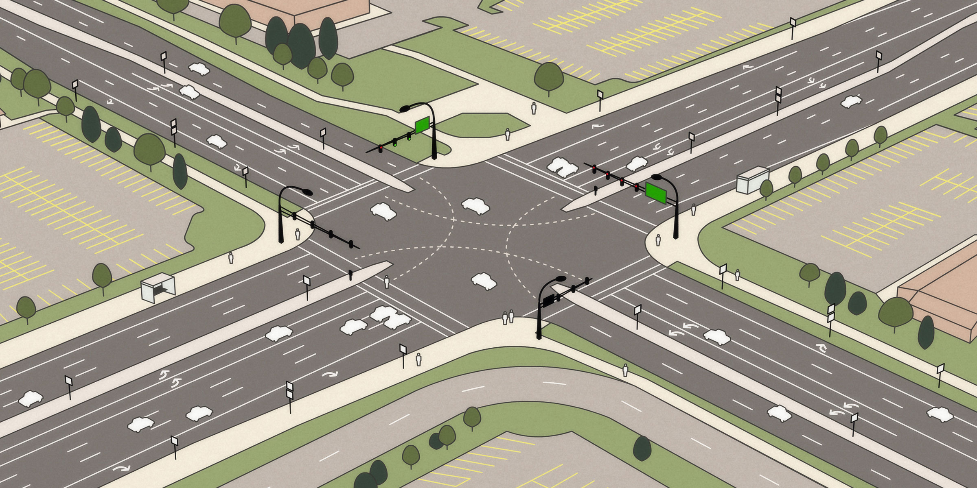


Overall view
MQTT broker
Relay
Node
Vehicle
Counter
Sensor
Nodes

Slide 8
Modules

Slide 9
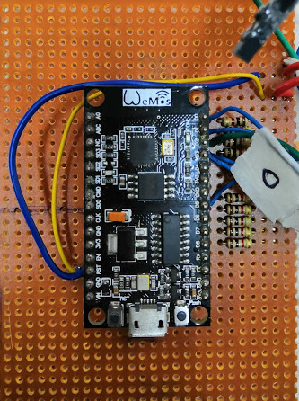
Prototype
4 Sensor Nodes
9 Magnetic Reed switches inputs
ESP8266 microcontroller
Get count using reed switches
Publishes vehicle count

Slide 10
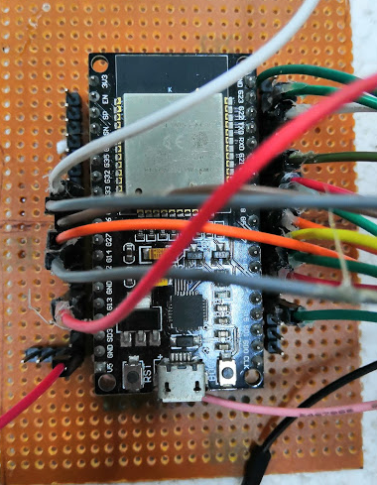
Prototype
Relay Node
ESP32 microcontroller
Controls color-lights

Slide 11
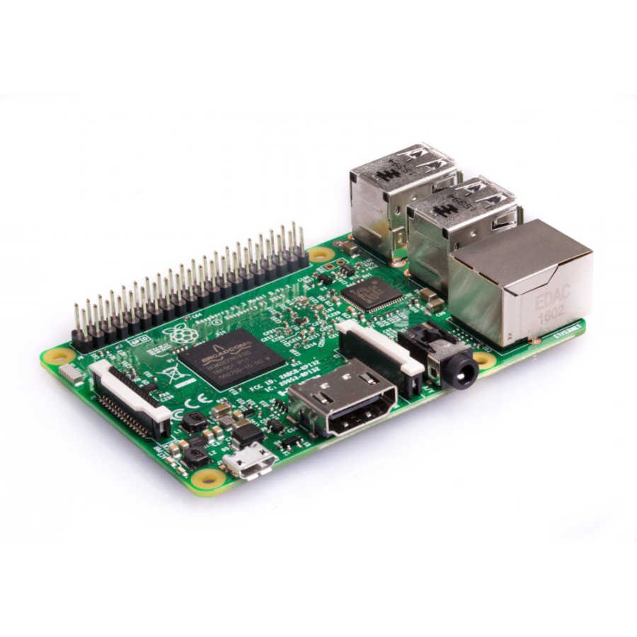
Prototype
Broker
Raspberry Pi 3
Runs traffic controlling algorithm
Publishes color-light control signals
Identify disconnected sensor nodes and inform

Slide 12
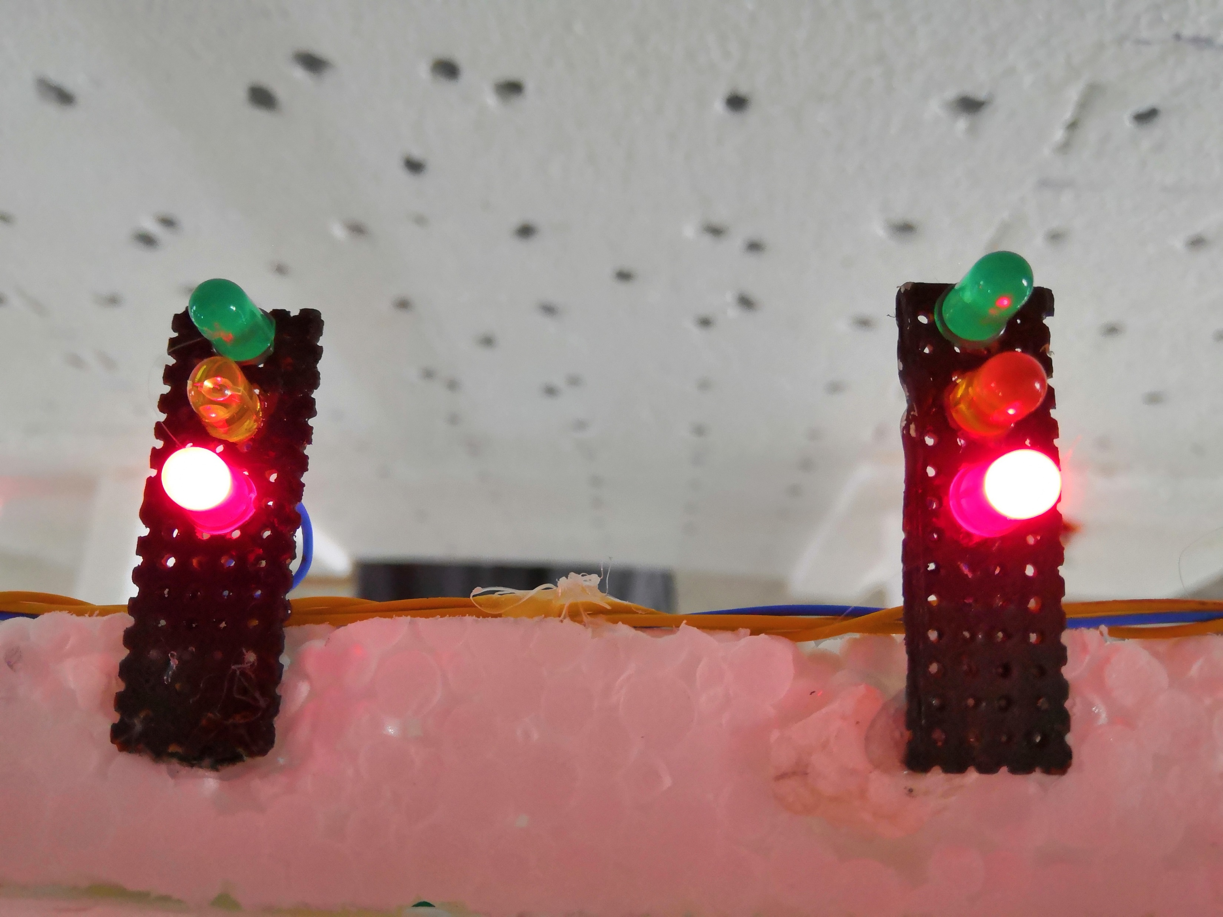
Prototype
8 Color-light modules
Controlled by the Relay Node

Slide 13
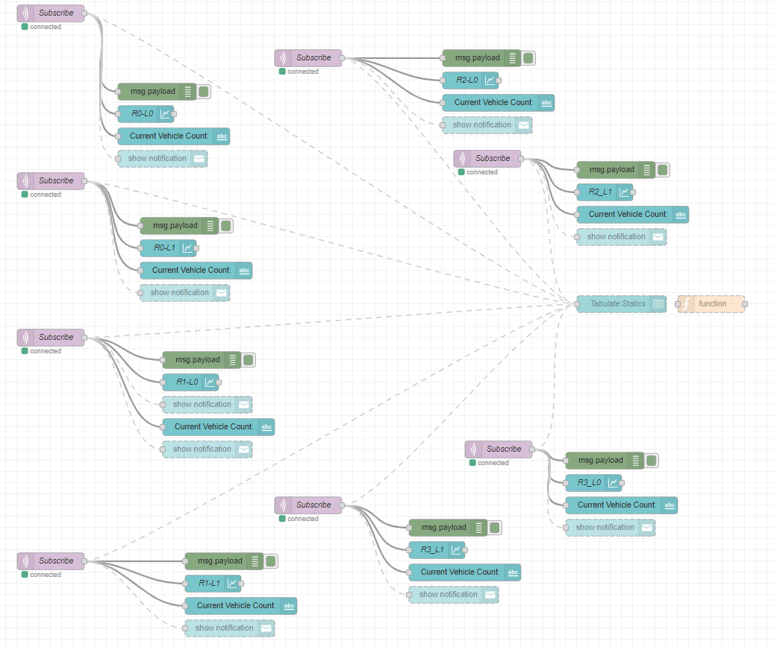
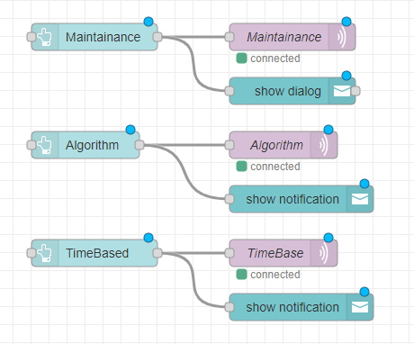
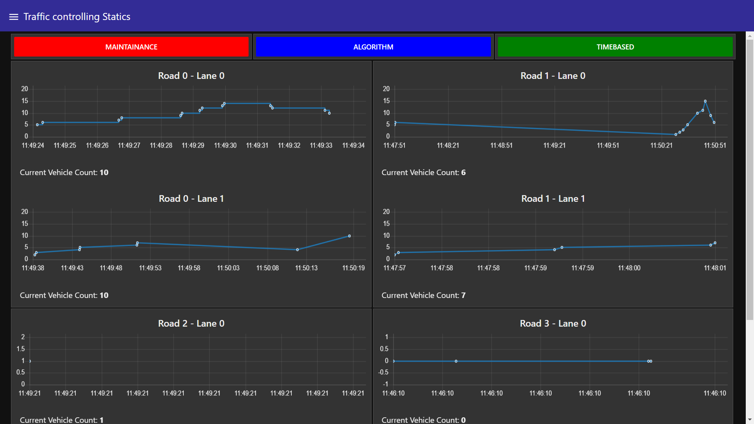
Prototype
Node-red GUI
Shows real-time vehicle count in each lane
Control Panel including
Time-based/ Automated / Maintenance

Slide 14
Demonstration

Slide 15
Demonstration
A basic vehicle controlling algorithm
What if ?
Broker
fails
recover
A Sensor node
fails
recover

Slide 16
Thank You !

Slide 17
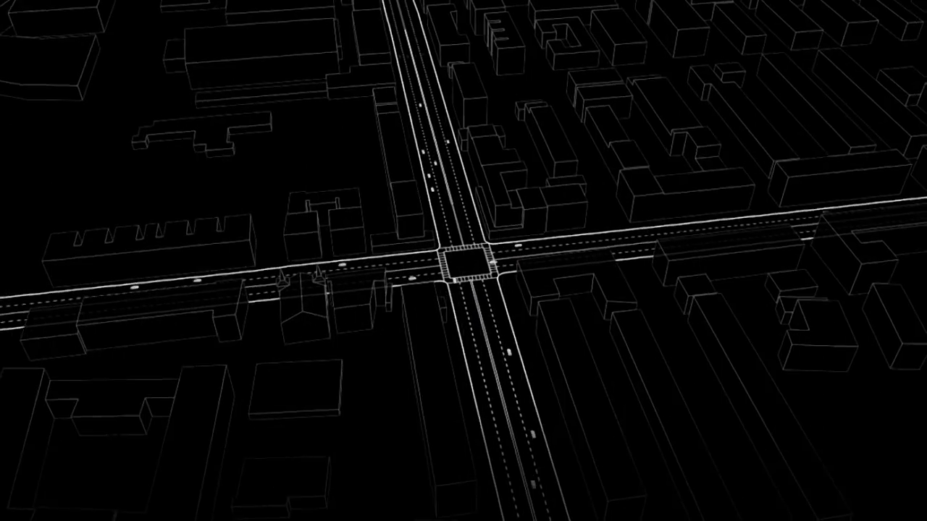
Q & A

